Slide 1
Attendance Recording System Using Machine Learning
Submitted by
20R21A1204 A.DEEPIKA
20R21A1231 K.SHIVA SAI
20R21A1250 S.YESHWANTH REDDY
20R21A1227 K.KARTHIKEYA REDDY

Slide 2
ABSTRACT
The existing methods to mark attendance are very time taking and require human presence , by employing new methods and technologies the attendance marking task can be reduced in time and work. Face recognition using machine learning techniques are used to detect and recognize the trained faces, attendance is then marked to recognized faces. This application is very handy by using this application proxy attendance is not possible and make the process of marking attendance more efficient such as if a person is attending to an exam in offline or online mode he cannot send any other person to write his/her exam if he/she do so they will be immediately identified .

Slide 3
INTRODUCTION
Traditionally attendance is marked manually by teachers and they must make sure correct attendance is marked for respective student. This whole process wastes some of lecture time and part of correct information is missed due to fraudulent and proxy cases. Face recognition is a biometric method of identifying an individual by comparing live capture or digital image data with the stored record for that person . Face recognition attendance system is marking of attendance based on the technology.This application is used to terminate proxy attendance and to reduce the time and efforts of human . By using this attendance marking task can be reduced in time and work and human presence is not required while marking the attendance .

Slide 4
EXISTING SYSTEM
In existing system human presence is required to mark attendance this process is time taking and there are very high chances of proxy attendance and sometimes people who are present in the class are marked as absent due to human errors

Slide 5
DISADVANTAGES
Consume more time
Requires human presence
High chance of proxy attendance

Slide 6
PROPOSED SYSTEMS
In this system we use face recognition for marking the attendance instead of traditional way of marking the attendance which consumes more time and requires human efforts In order to determine classroom attendance, face detection and face recognition are performed.
Face detection is used to determine the location of the faces in the classroom image and extract sub images for each face. Then, in face recognition, the face images detected will be compared with the data base consisting of images of students in the class, and attendance will be recorded accordingly.

Slide 7
ADVANTAGES OF PROPOSED SYSTEM
Time and efforts can be reduced
Human presence is not required
No chance of proxy attendance

Slide 8
SOFTWARE REQUIREMENTS
Software:
Machine learning using python

Slide 9
ALGORITHUM
The LBPH algorithm typically makes use of 4 parameters:
Radius:
The distance of the circular local binary pattern from the centre pixel to its circumference and usually takes a value of 1.
Neighbors:
The number of data points within a circular local binary pattern. Usually, the value of 8.
Grid X:
The number of cells in the horizontal plane, is usually a value of 3.
Grid Y:
The number of cells in the vertical plane, is usually a value of 3.

Slide 10
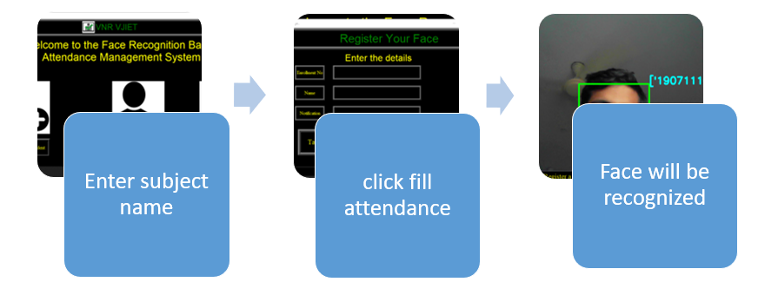
Process flow for taking attendance :

Slide 11
CONCLUSION
We made a machine learning model and it is successfully recognizing trained faces for marking attendance. The model is accurate and detects with minimum error. The user interface is also developed for the model , it is user friendly and very simple.

Slide 12
REFERENCE
https://youtu.be/A6464U4bPPQ
https://www.analyticsvidhya.com/blog/2021/11/build-face-recognition-attendance-system-using-python/

Slide 13
THANK YOU

